Slide 1
Rolling 3D Objects
Hossein Baktash
Mentors: Alec Jacobson, Qingnan(James) Zhou

Slide 2

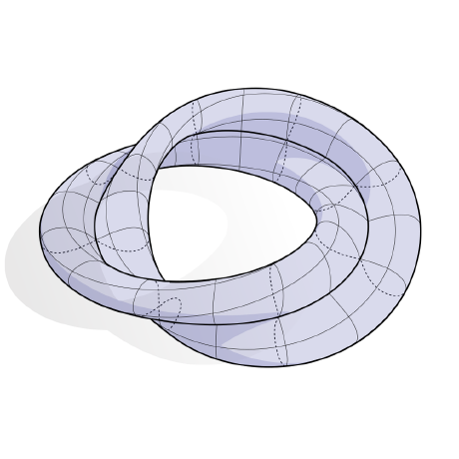

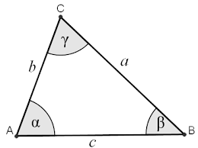
About Me
Hi I’m Hossein Baktash!
2nd year PhD student at CMU
Advised by Prof. Keenan Crane
Member of the Geometry Collective team
Hobbies
Pool (billiards)
Hiking
Drawing
Interested in any problem that has geometry!
Geometry processing
Graphics
Differential Geometry
…

Slide 3


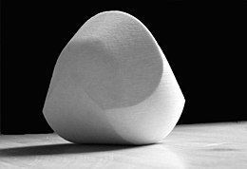

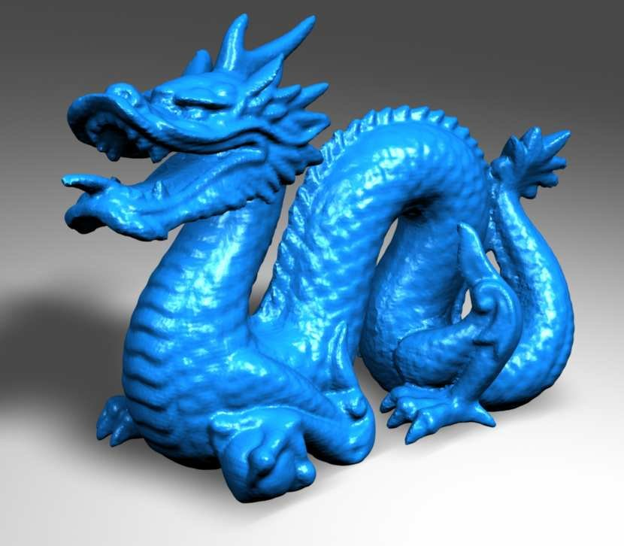
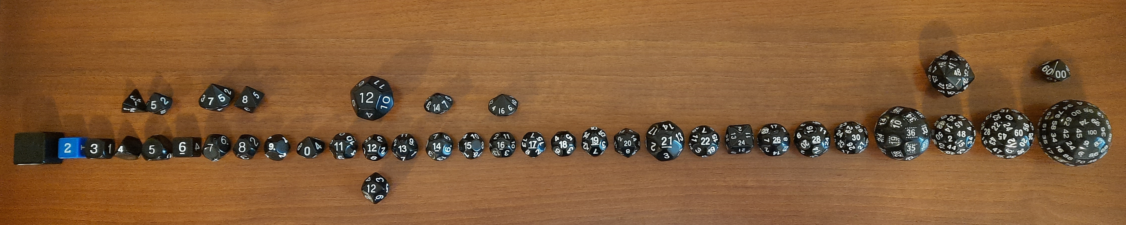
Objects fall on the ground!!
Gömböc
Can we determine how an object will end up on the ground?

Slide 4


Determining an object’s final stable configuration
Using a rigid body simulator
Drop an object, see how it lands..
What if we want to find the probability of stabilizing in any configuration?
Using a simulator, and sampling all possible initial orientations
Too slow!

Slide 5
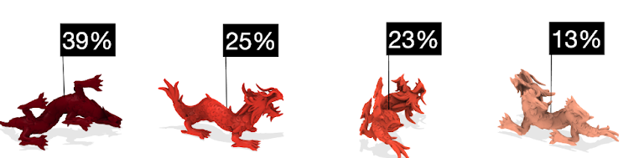
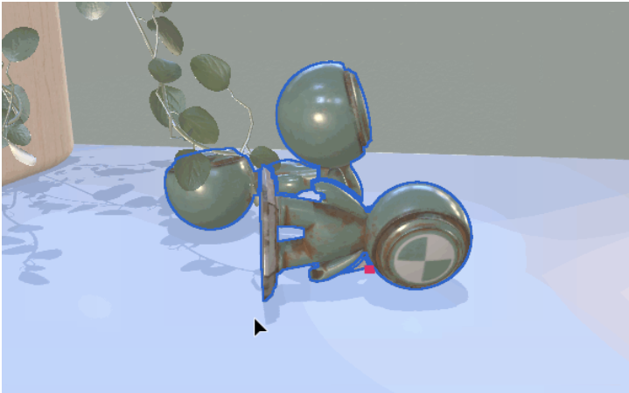
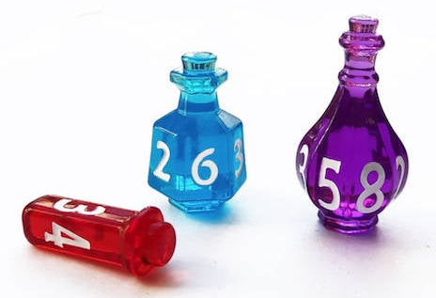
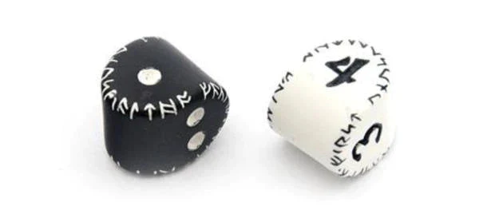

Finding probability of all configurations efficiently
Determining upright object layouts
Designing/modifying objects to stand/roll in a certain way
Making robots that move by only changing their center of mass
A polyhedral bb-8

Slide 6
Can we find these probabilities efficiently?

Slide 7
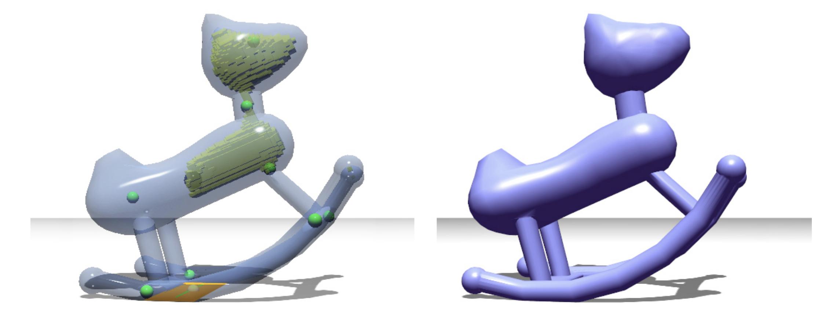
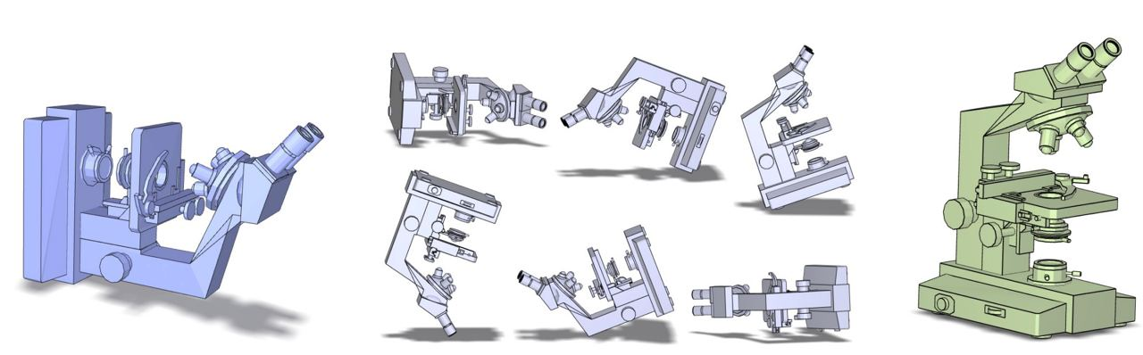
Related Work
Prévost, Romain, et al. "Make it stand: balancing shapes for 3D fabrication" ACM Transactions on Graphics (TOG) 2013.
Fu, Hongbo, et al. "Upright orientation of man-made objects” ACM SIGGRAPH 2008.

Slide 8




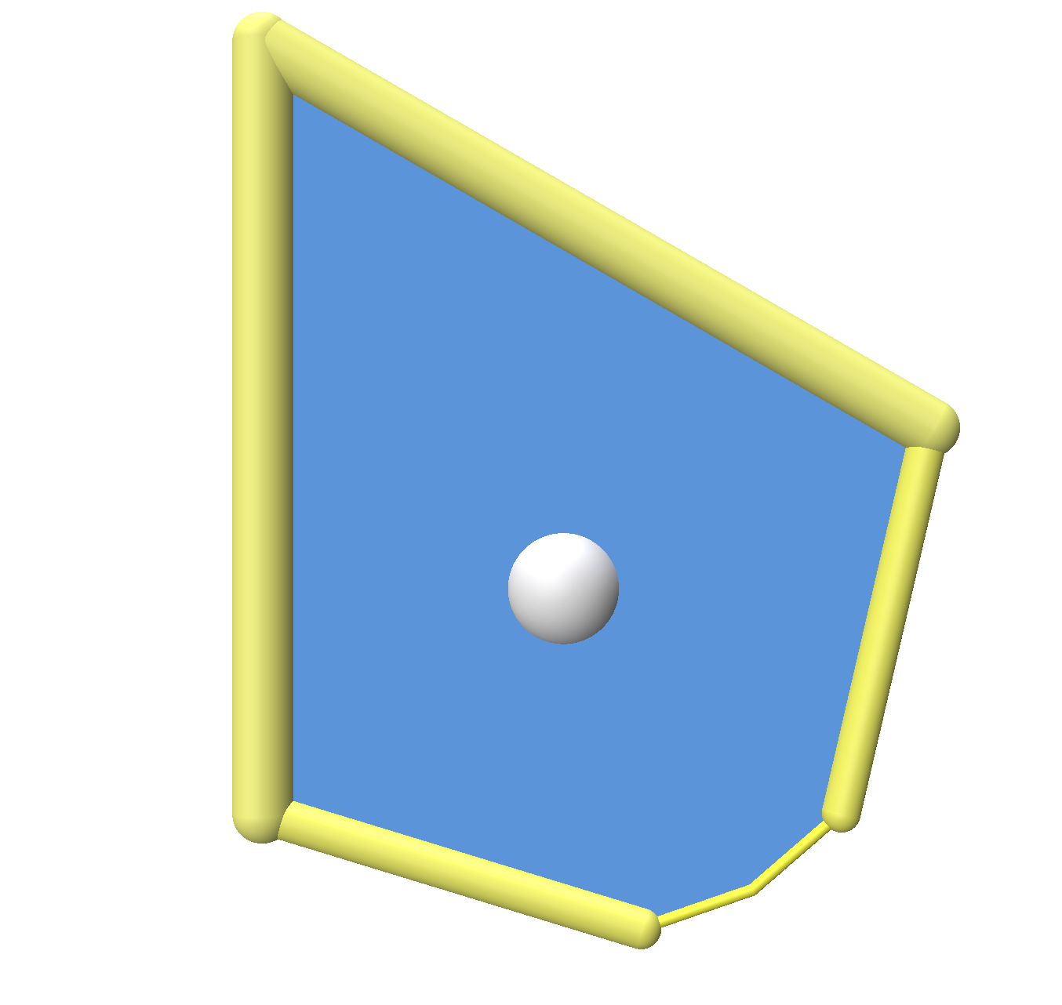

Project Plan
Explore the problem in 2D

Slide 9
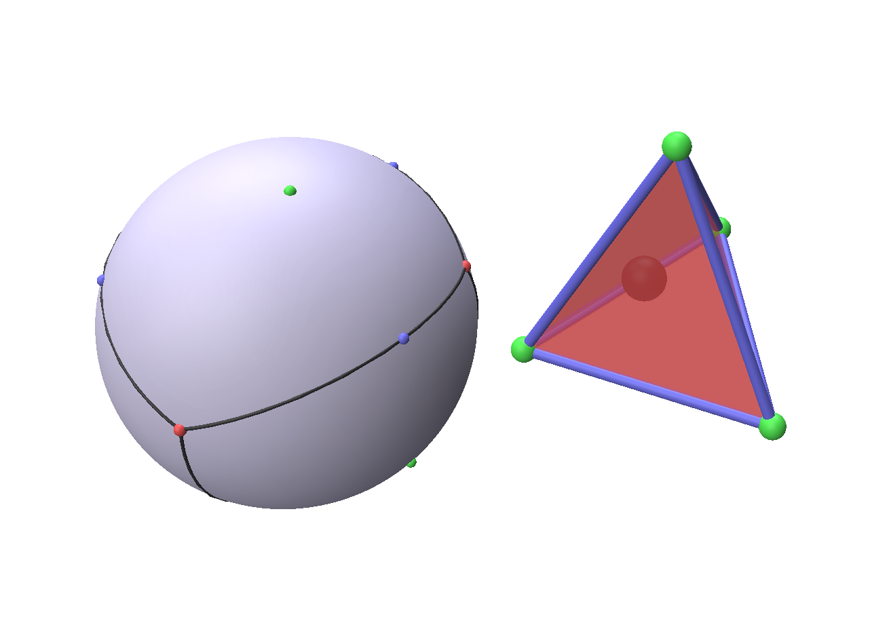
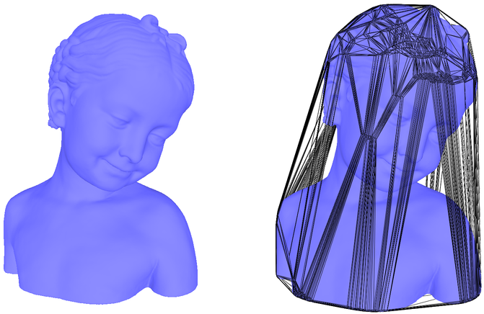
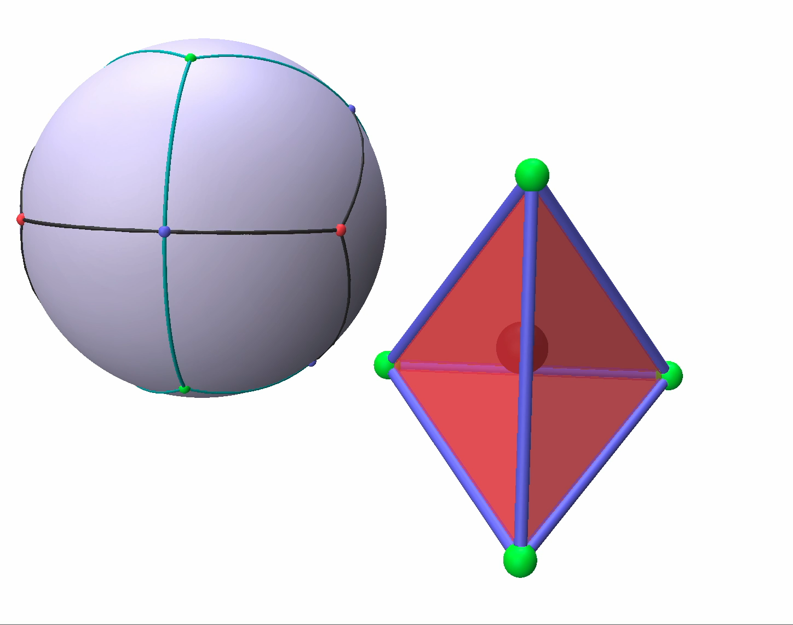
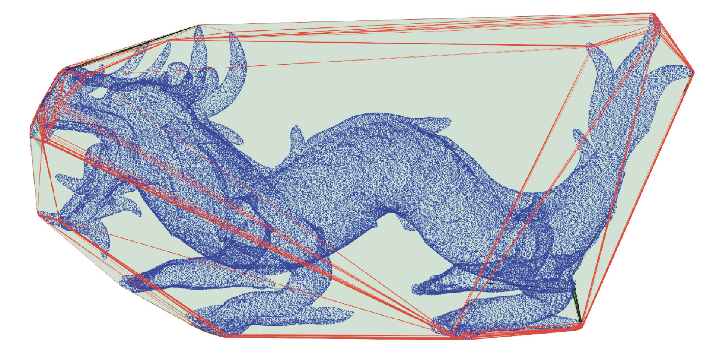
Project Plan
Understand the problem in 3D
The rolling process can be seen as a walk on a sphere
Only need the convex hull

Slide 10
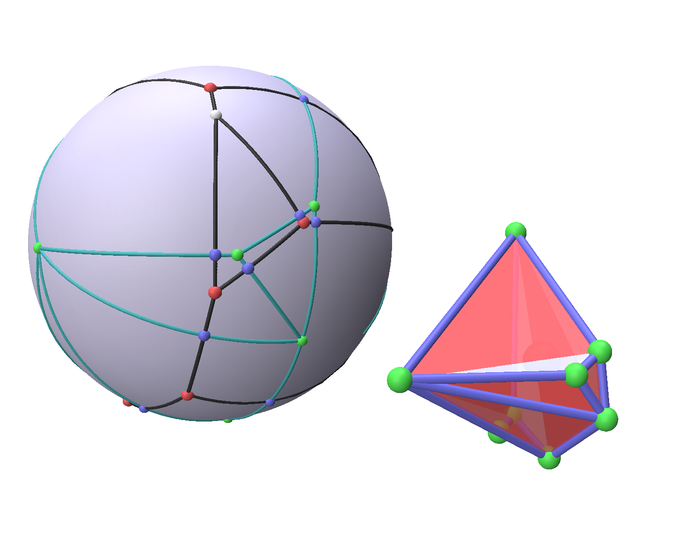
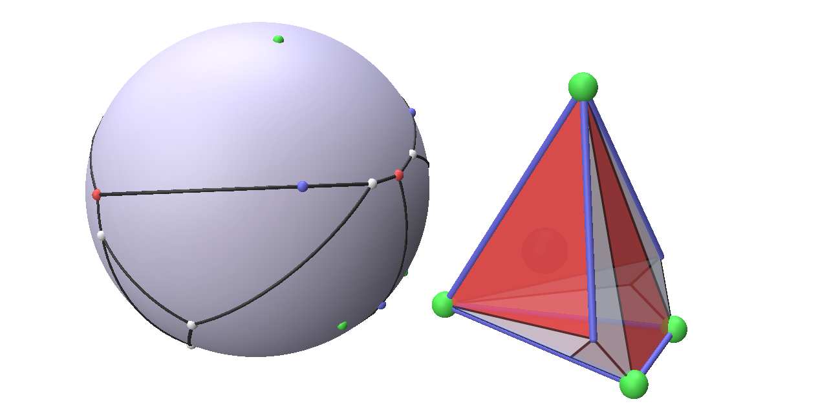
Project Plan
Understand the problem in 3D
Solve for the difficult cases; e.g. rolling from a face/edge onto a vertex

Slide 11
Future directions
Solve the inverse design problem
Assume initial momentum for the object
Solve the 3D case
Explore moving objects by changing the center-of-mass

Slide 12
Thank you for your time!
@hbaktash

Slide 13
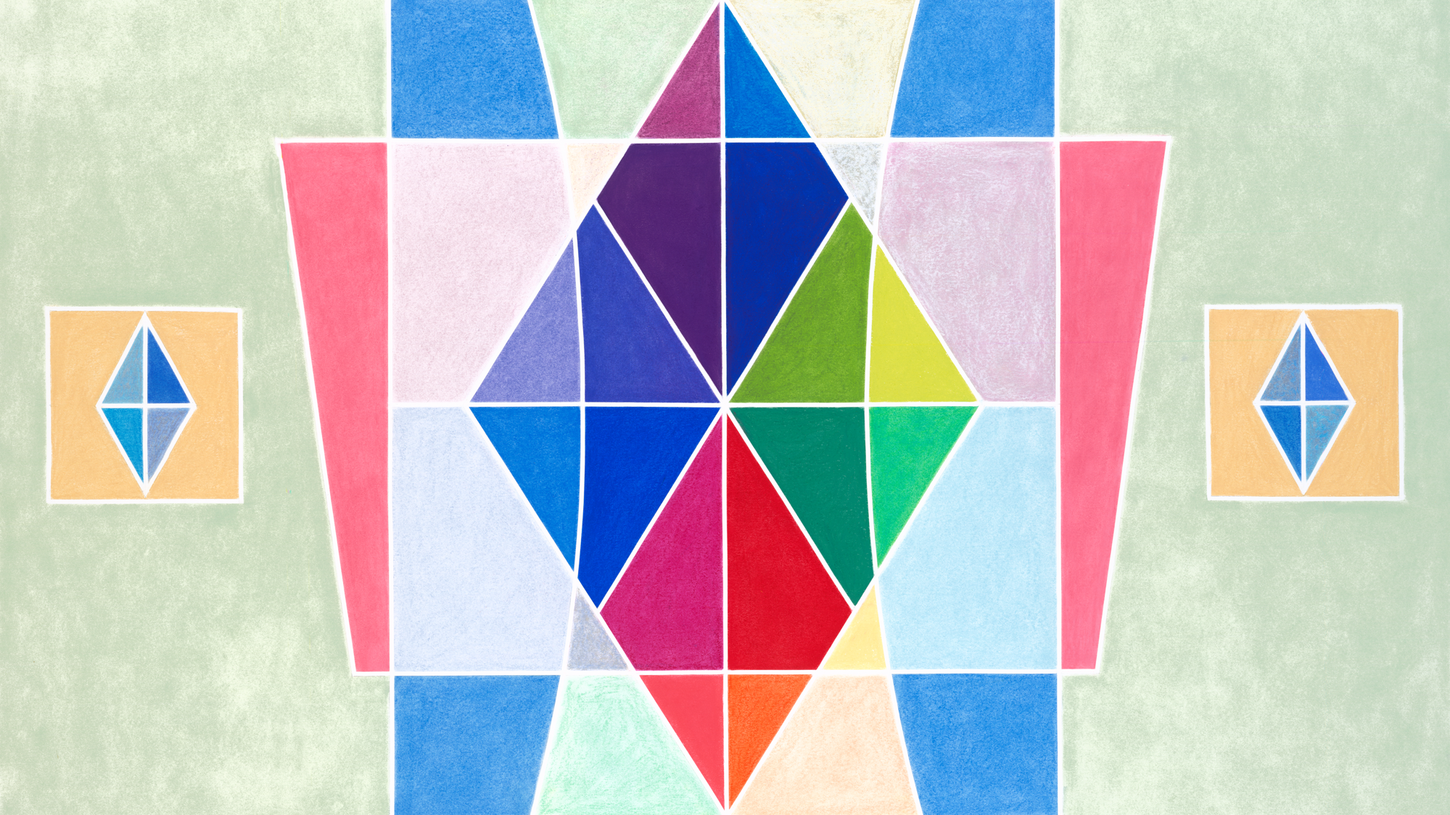


Slide 14
Feedback Request
@yourSlackUsername
What feedback do you want to get from the audience? (only 2-3 brief questions, please!)
Question 1
Question 2
Question 3
This is good to have early in your talk so that the audience can watch with these questions in mind.
TIP: This is a great opportunity to work with your mentor to brainstorm what type of feedback would be most useful for you!
(OPTIONAL) It is useful to provide your username to encourage people to send feedback after the talk.

Slide 15
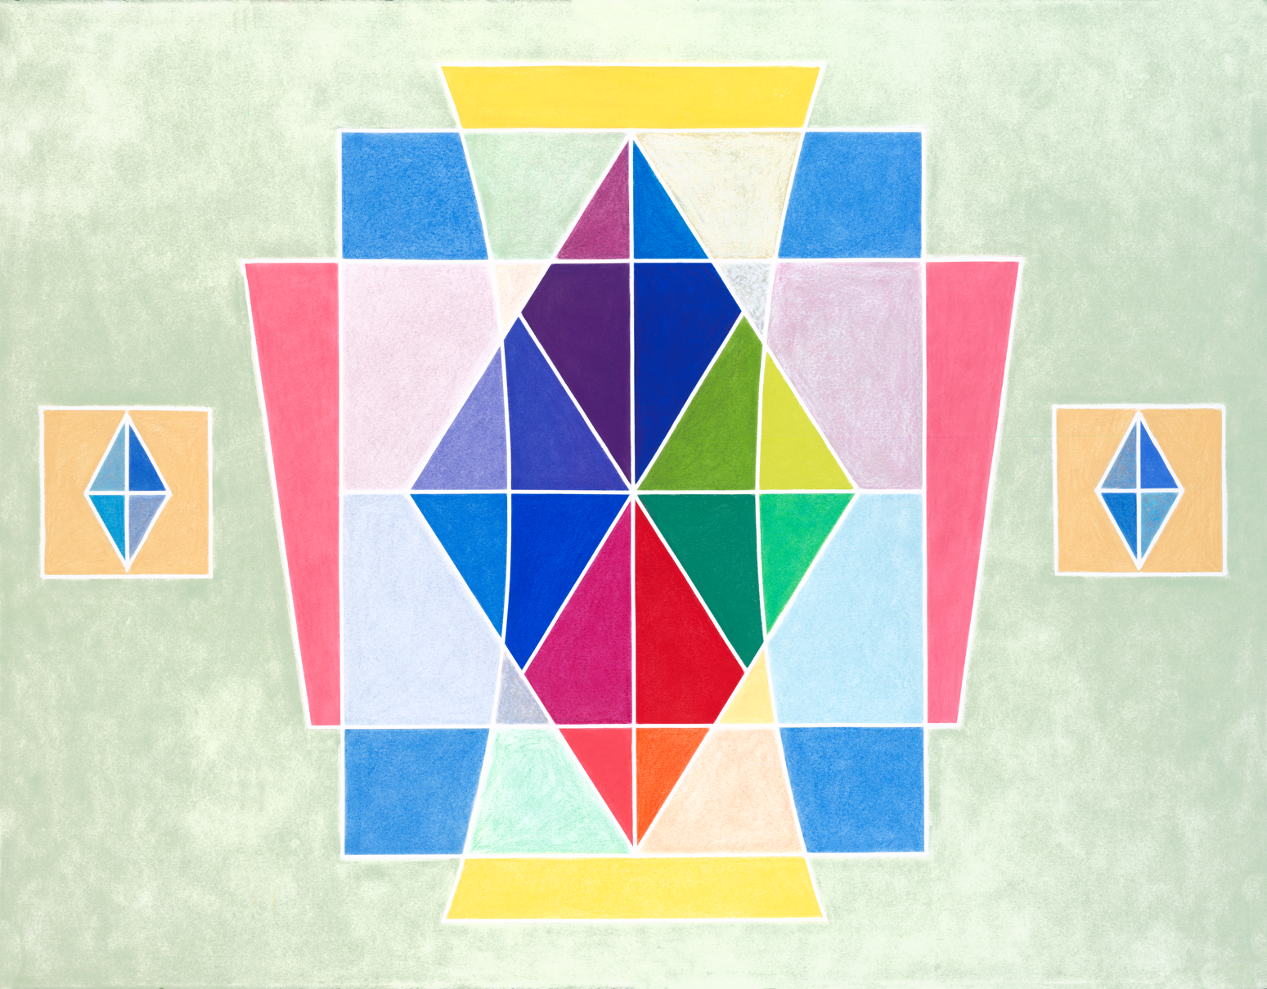
About the artist
Alicia Sterling Beach
Los Angeles-based artist Alicia Sterling Beach uses watercolors, colored pencils, and soft pastels to bring beauty into the world. Growing up with the vivid colors and music of Latin America, as well as the Native cultures of the American Southwest, her artwork is informed by her history and inspired by nature, light, and classical music. Beach’s work is featured on artlifting.com, a platform for artists impacted by housing insecurity and disabilities. In this piece, she combines symmetry and joyful colors to express balance, harmony, and spiritual attainment.

